Slide 1


AIBridge
Lecture 1: Intro to Python
Notes:
Welcome. Hi. Go over Python. ADD LECTURE1DemoFile.txt file

Slide 2
Lecture Outline
Google Colab
I/O
List Manipulation
General Python Syntax
What is a function?
Variables
Built-ins
Logic
Importing
Control Flows
Notes:
How to use and why we use it

Slide 3
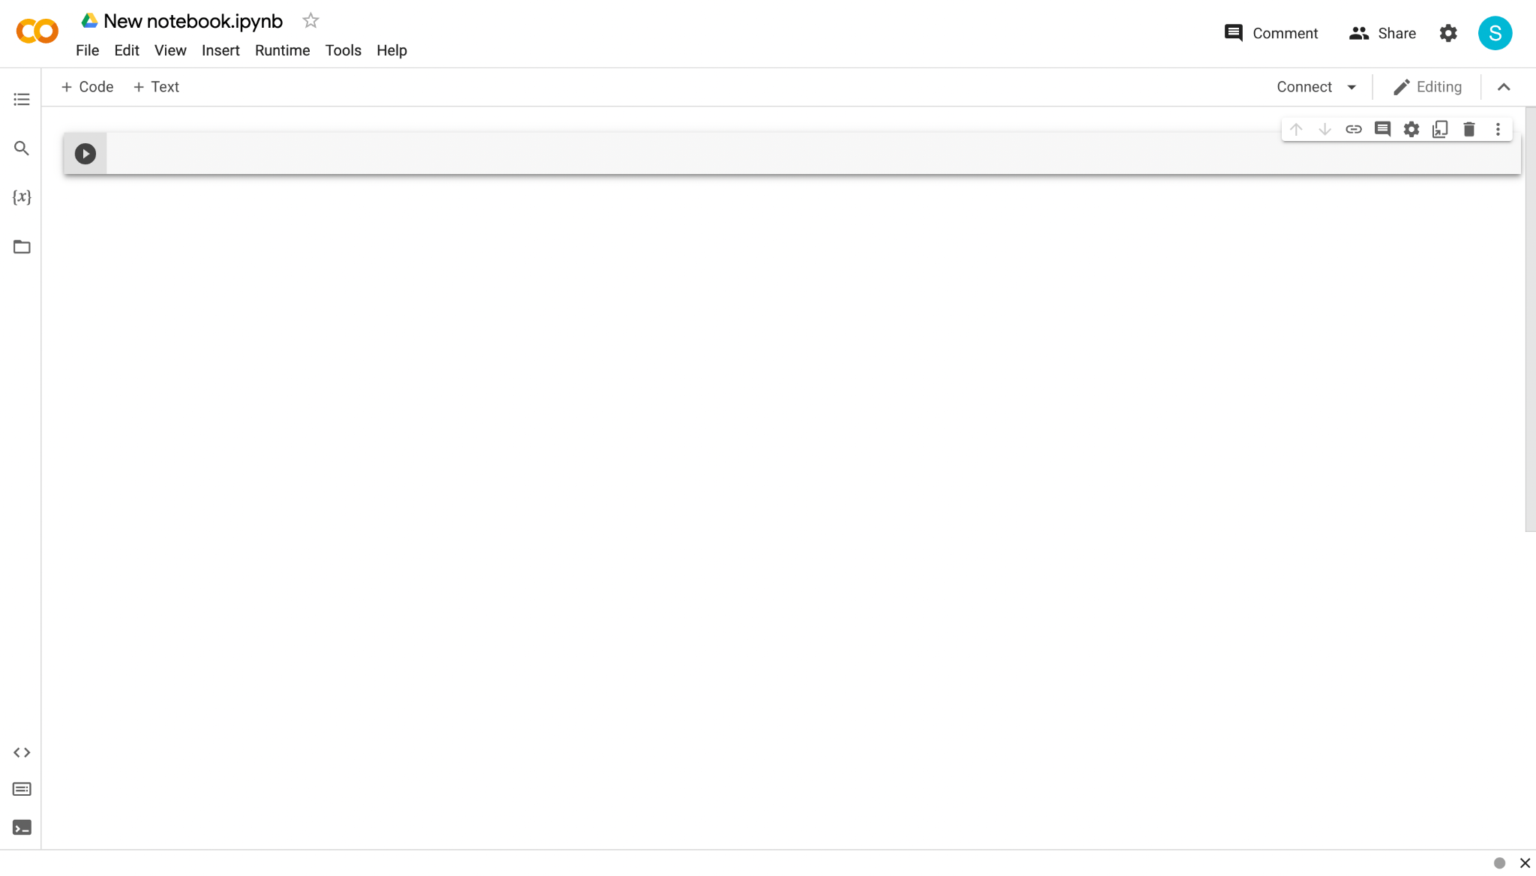
Google Colab
https://colab.research.google.com/
Stores everything on Google Drive
Can be shared with others and across devices
No setup required
Most packages/libraries preinstalled
Colab Pro
Follow along as we work through the Python language
Notes:
Similar to Jupiter notebook
Place to write and run code
First the why: we want to get you to ML as soon as possible. This is the easiest way to start.
Colab major advantages: no need to install any packages/libraries, easy to share with others or access from multiple devices. kind of like Google Docs or Google Slides bc everything is stored on your own Google drive.

Slide 4

Google Colab
Delete cells by clicking this button
Add new cells by clicking “+ Code”
Write code inside “cells”
Run a cell by clicking this button
Notes:
Let’s take a look at the Google Colab user interface. (click)
All your code will be written in cells, like this. (click)
You can add additional cells using this small button on the left… (click)
…and delete cells by clicking the button on the right of the specific cell. (click)
In order to run the code within a certain cell, you can click the run button of the left of the desired cell.
colab
Run all
File access
questions?

Slide 5
Lecture Outline
Google Colab
I/O
List Manipulation
General Python Syntax
What is a function?
Variables
Built-ins
Logic
Importing
Control Flows

Slide 6
General Python Syntax
Getting Started
Comments allow sections of the code to be more readable
Anything after a “#” is a comment
# I am a comment!
Indents are required, serving the function of curly brackets (use tab key)
Notes:
Comments -> used to improve readability so that when you or other people look at your code, they would immediately understand what you are trying to do.
Comments -> plain english -> for you not the machine
You will know when something is commented because it will turn green. Start with a “#” hashtag
Indents -> tell the computer which section of code it is under. Stress that tabs or four spaces are required because otherwise the computer won’t be able to understand what the programmer is trying to do and would often times throw an error.
Questions?

Slide 7
Lecture Outline
Google Colab
I/O
General Python Syntax
List Manipulation
Variables
What is a function?
Logic
Built-ins
Control Flows
Importing

Slide 8
Variables
Overview
A variable is a reserved place in memory (think: container) which can store a value
Creating variables: variable_name = value
Can be used anywhere after its assignment, but never before
Can re-assign values as needed
7 types of values: Integer, Floating-point, String, Boolean, List, Tuple, and Dictionary
(More details about each type coming up in next slides)
var_a = 25
var_a = 70
print(var_a)
Notes:
Variables -> used to store/hold values that we can reuse over and over again -> we don’t have to remember the exact values but we can just use and reference the name of the variable knowing what it corresponds to
2 steps -> declare (give the name) + initialize (set it to a value), use
Must be in that specific order -> can’t use variables before declaration or initialization
Python is dynamically typed -> you don’t have to declare what type each variable is.

Slide 9
Variables
Names
"3rd_variable"
Cannot start with a number
Cannot include spaces
Cannot be a keyword: https://www.w3schools.com/python/python_ref_keywords.asp
Should be descriptive
*Good practice: all lowercase with underscores for spacing
Good examples: datapoint_number, petal_width, ...
"my variable"
Notes:
Let’s go over some rules involving variable names. There are a couple hard rules that must be followed otherwise your program will break. There are also some soft rules that are just good practice.
These first three are hard rules so you must follow them.
cannot start with a number. This is to prevent the computer from confusing a variable with a number.
variables cannot have spaces. Use underscores instead.
variable names cannot be the same as a keyword that’s already used by Python and is reserved for other purposes. Don’t need to remember keywords
Additionally, these last two are soft rules that are good practice.
Variable names should be descriptive. You will likely be using the same variables over and over again, so giving them a good name makes it easy to remember what their purpose is.
variables should follow the snake case convention. This means they should be composed of all lower case letters with underscores for spacing.
slides with asterisks on it -> it is a slightly more advanced topic or syntax. You are not required to memorize or use these topics.

Slide 10
Variables
Self-test
70 ⇒ because the value of variable_b is set to be 70 in the second line
40 ⇒ because the value of variable_b is set to be the same as variable_a which is 40
25 ⇒ because the value of variable_b is set to be the same as variable_a which is 25
What does the following code output?
variable_a = 25
variable_b = 70
variable_a = 40
variable_b = variable_a
print(variable_b)

Slide 11
Variables
Self-test
70 ⇒ because the value of variable_b is set to be 70 in the second line
40 ⇒ because the value of variable_b is set to be the same as variable_a which is 40
25 ⇒ because the value of variable_b is set to be the same as variable_a which is 25
What does the following code output?
variable_a = 25
variable_b = 70
variable_a = 40
variable_b = variable_a
print(variable_b)
Notes:
Colab
Also mention that typing in the variable will print it.

Slide 12
Variables
Integer
Non-fractional number
Positive or negative
No maximum or minimum practically
first_number = 1
second_number = 5
third_number = -3
Notes:
One type of data you can store within a variable is an integer.
An integer is a…

Slide 13
Variables
Floating-point
“Float”
Decimal point number
Accurate within 2⁻⁵⁵
petal_length = 3.5
petal_width = 4.0
pi = 3.14159265358
3.1415926
Floating (Decimal) Point
Notes:
Another type of number is a floating point number, more commonly known as a decimal point number.
Floating point numbers can have very long decimals, and will be accurate within this range (point) which for most purposes is perfectly accurate.

Slide 14

Variables
String
Not this
A string of characters
Put in quotations " " or ' '
*Block string (multi-line string): three quotation marks
*Special character (new line): "\n"
first_string = "s"
second_string = "string 2"
second_string = "another string"
Notes:
Very important datatype We will use this a lot when we deal with data.
Not mismatching the quotations
Multiline and \n
Colab Ask audience for string recommendations

Slide 15
Variables
Boolean
True or False (capitalize)
first_boolean = True
second_boolean = False
Notes:
When we talk about controls, we will be using Boolean

Slide 16
Variables
List
[a, b, c, d, e]
0 1 2 3 4
-5 -4 -3 -2 -1
A list of values
my_list = [value_1, value_2, ...]
example_list = [5, 20, 11, 3, 10]
Can include multiple different data types
multi_type_list = ["hello world", True, 5]
For a specific value in the list: my_list[index]
The index of the 1st item is 0,
a_value = my_second_list[2] # gets the THIRD value in the list
There is also negative indexing (index of -1 gets last element, -2 gets second from last, etc.)
Notes:
A list is very commonly used in python, a list contains a series of values, even other lists.
Just like strings we will be using list and list manipulation very often
Lists are created within square brackets.
elements can be accessed individually using a square bracket operator. In programming, counting often starts at 0. So, in order to get the first element in an array, you need to put the number 0 within the square brackets. Backwards indexing
What do we think 0 would print etc… 1,2,-1,-2,-3 colab

Slide 17
Variables
Self-test
22 ⇒ because value is set to the second item in the list
23 ⇒ because value is set to the third item in the list
What does the following code output?
my_list = [21, 22, 23, 24, 25]
value = my_list[2]
print(value)

Slide 18
Variables
Self-test
22 ⇒ because value is set to the second item in the list
23 ⇒ because value is set to the third item in the list
What does the following code output?
my_list = [21, 22, 23, 24, 25]
value = my_list[2]
print(value)
Notes:
colab

Slide 19
Variables
* Tuple
Works the same as a list, but can’t be changed
Can contain multiple different data types
my_first_tuple = (object_1, object_2, ...)
my_second_tuple = (22, "hello!", True, 3.1415)
a_value = my_second_tuple[2] # gets the THIRD value in the tuple
Notes:
We will not cover Tuple and Dictionary (following slide) in this program. The slides are here for your information.
Like a list, a tuple is used to hold many variables. A tuple is created when you surround comma separated values within parentheses, in contrast to a list which uses square brackets.
The difference from the list is that it can’t be changed -> immutable
colab

Slide 20
Variables
* Dictionary
A list of values with custom keys that are indices, like a list but indices are keys and not positions
my_dictionary={'apple':'fruit', 'banana':'fruit', 'cabbage':'vegetable', 'dragonfruit':'fruit', 'eggplant':'vegetable'}
print(my_dictionary['cabbage'])
Notes:
Think of it like a dictionary. Key→value like term→definition
In this example, the print statement prints the value with a string “cabbage” as its key. Looking at the previous line, the value with a key of “cabbage” is the string “vegetable”.
Notice how you still use the square brackets to access individual elements similarly to lists and typles.
colab

Slide 21
Variables
Type Conversion
Types: int, float, str, bool, list, tuple
Convert types of variables to other types
my_float = float(my_string) #gives string in float form if possible
Compatible types:
int → float
float → int (always rounds down)
str → int
str → float
*[most types] → string
*list → tuple
*boolean → int/float (0 → False, anything else → True)
*str → list/tuple (only converts str to list/tuple of single characters)
Notes:
When we want to convert a variable’s data type to another
Useful -> perform operation on different data types (unite them) or -> store a value of one data type into a variable of another
List of viable conversions
Colab. questions?

Slide 22
Variables
Basic Arithmetic Operations
+ | - | * | ** | / | // | %
Addition | Subtraction | Multiplication | Exponentiation | Division (turns int to float) | Floor Division (rounds down the quotient) | Modulus (returns the remainder)
x + y 1 + 2 == 3 | x - y 2 – 1 == 1 | x * y 2 * 3 == 6 | x ** y 2 ** 3 == 8 | x / y 8 / 2 == 4.0 | x // y 9 // 4 == 2 | x % y 10 % 4 == 2
Note: the double equal sign a == b is used to check for equality instead of assigning variables
Notes:
Explain floor division and modulus
colab

Slide 23
Lecture Outline
Google Colab
I/O
List Manipulation
General Python Syntax
What is a function?
Variables
Built-ins
Logic
Importing
Control Flows

Slide 24
Logic
Conditionals
if statement_1:
Code segment 1
elif statement_2: # elif means else if
Code segment 2
else:
Code segment 3
Notes:
Explain it as pseudo-english
Goes in order if one condition is met, the others won’t run.
Helps you determine whether a condition is true of false -> do specific actions based on specific conditions

Slide 25
Logic
Conditionals
x =
y =
if x == y:
print('x is equal to y')
elif x > y:
print('x is greater than y')
else:
print('x is less than y')
1
1
Notes:
Ask audience what they expect it to do

Slide 26
Logic
Conditionals
x = 4
y =
if x == y:
print('x is equal to y')
elif x > y:
print('x is greater than y')
else:
print('x is less than y')
1
Notes:
Ask audience what they expect it to do

Slide 27
Logic
Conditionals
x = 4
y =
if x == y:
print('x is equal to y')
elif x > y:
print('x is greater than y')
else:
print('x is less than y')
10
Notes:
Ask audience what they expect it to do

Slide 28
Logic
Conditionals
== != < > <= >=
== True if the two sides are exactly the same (1 == 1 is True)
!= True if the two sides are NOT the same (2 != 1 is True)
Notes:
Comparison operators
Often used in if statements to test certain conditions

Slide 29
Logic
Conditionals
and: only runs if both are True
if 1 == 1 and 1 == 2:
code segment…
or: runs if at least one of them are True
if 1 == 1 or 1 == 2:
code segment…
Notes:
Logic Operators

Slide 30
Logic
Self-Test
petal_width = 1.8
petal_length = 3.5
if petal_width < 3 or petal_length < 3:
print("condition 1 passed")
if petal_width < 3 and petal_length < 3:
print("condition 2 passed")
if petal_width < 3:
if petal_length < 3:
print("condition 3 passed")
Which of these conditions are successfully passed?

Slide 31
Logic
Self-Test
petal_width = 1.8
petal_length = 3.5
if petal_width < 3 or petal_length < 3:
print("condition 1 passed")
if petal_width < 3 and petal_length < 3:
print("condition 2 passed")
if petal_width < 3:
if petal_length < 3:
print("condition 3 passed")
Which of these conditions are successfully passed?
Notes:
Colab. questions?

Slide 32
Lecture Outline
Google Colab
I/O
Google Colab
List Manipulation
General Python Syntax
General Python Syntax
What is a function?
Variables
Variables
Built-ins
Logic
Logic
Importing
Control Flows
Control Flows

Slide 33
Control Flows
Hypothetical Scenario
We have this very large list of 11 words:
How do we access and print out every word?
word_list = ["Lorem", "ipsum", "dolor", "sit", "amet", "fusce", "rhoncus", "mi", "viverra", "velit", "mattis"]

Slide 34
Control Flows
Hypothetical Scenario
word_list = ["Lorem", "ipsum", "dolor", "sit", "amet", "fusce", "rhoncus", "mi", "viverra", "velit", "mattis"]
print(word_list[0])
print(word_list[1])
print(word_list[2])
print(word_list[3])
print(word_list[4])
print(word_list[5])
print(word_list[6])
print(word_list[7])
print(word_list[8])
print(word_list[9])
print(word_list[10])
Horribly inefficient
A lot of tedious manual coding
Completely unscalable (what if there were 70 words)
Notes:
(click)

Slide 35
Control Flows
Hypothetical Scenario
print(word_list[0])
print(word_list[1])
print(word_list[2])
print(word_list[3])
print(word_list[4])
print(word_list[5])
print(word_list[6])
print(word_list[7])
print(word_list[8])
print(word_list[9])
print(word_list[10])
Only difference between all these lines is the index
Notes:
Ask if anyone sees a pattern
(click)

Slide 36
Control Flows
For Loops
How to use: for iterator in iterable:
String, list, range, etc.
Need indentation
word_list = ["Lorem", "ipsum", "dolor", "sit", "amet", "fusce", "rhoncus", "mi", "viverra", "velit", "mattis"]
for number in range(0, 11): #range goes through 0, 1, 2, … 10
#this loop repeats 11 times and number changes to each number
print(word_list[number])
Notes:
An iterable is anything that can be looped over (like a list or string).
iterator/the iteration variable is a variable whose value can be changed each time a loop iterates.
Repeat for a known number of times
Uses the range function
Colab

Slide 37
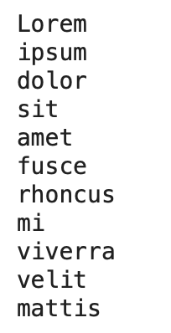
Control Flows
Self-Test
Output:
word_list = ["Lorem", "ipsum", "dolor", "sit", "amet", "fusce", "rhoncus", "mi", "viverra", "velit", "mattis"]
for word in word_list:
#this loop does the exact same thing but with less typing
print(word)
Notes:
Difference between this and in range
Click through animation

Slide 38
Control Flows
Self-Test
big_list = ["Lorem", "Ipsum", "Dolor", "Sit", "Amet", "Consectetur", "Adipiscing", "Elit", "Sed"]
Which of the following code blocks will print out everything in the list?
a.
for word in big_list:
print(word)
b.
for i in range(9):
print(big_list[i])
c.
for word in big_list:
print(big_list[word])

Slide 39
Control Flows
Self-Test
big_list = ["Lorem", "Ipsum", "Dolor", "Sit", "Amet", "Consectetur", "Adipiscing", "Elit", "Sed"]
Which of the following code blocks will print out everything in the list?
a.
for word in big_list:
print(word)
b.
for i in range(9):
print(big_list[i])
c.
for word in big_list:
print(big_list[word])

Slide 40
Control Flows
While
How to use: while statement:
The loop repeats as statement is true
Needs indentation
my_number = 0
while my_number < 6:
print(my_number)
my_number = my_number + 1
Notes:
A while loop is the other form of control flow. repeats as long as the statement is true -> end when a statement becomes false
Benefits: unlike the for loop you don’t actually need to know how many times you want to repeat the block of code
Be careful or it will run forever. colab
Coding experiment: swap the two lines in the while loop
Coding experiment: do not indent the second line in the while loop

Slide 41
Control Flows
Indentation
Don’t worry about what this code does.
a_list = [3, 22, 1, 73, 40, 3, 19]
sum = 0
for i in range(0, 7):
sum = sum + a_list[i]
sum = sum / 2.4
sum = sum * -1
print(a_list[i])
print(sum)
Inside loop because of indentation
(tab)
Notes:
Note the indentation -> shows that the following block of lines belong to that for loop
colab

Slide 42
Lecture Outline
Google Colab
I/O
List Manipulation
General Python Syntax
What is a function?
Variables
Built-ins
Logic
Importing
Control Flows

Slide 43
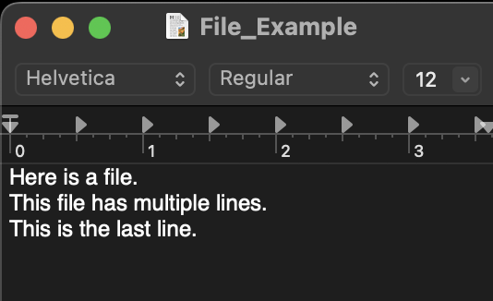
I/O
Standard Input
Input from console: input('prompt')
Open file: file_object=open(file, mode)
'r' is read and 'w' is write for the mode
read()
, readline()
, readlines()
Always close file: file_object.close()
"""Here is a file.
This file has multiple lines.
This is the last line."""
"Here is a file."
["Here is a file.",
"This file has multiple lines.",
"This is the last line."]
"This file has multiple lines."
"This is the last line."
Notes:
Input from console using input() (click)
Inputs example colab
Now, we don’t always want to be inputting like this into our code. Imagine doing that for thousands or even millions of numbers. Quite tedious. So how should we do this?
We can use python to read from a file. (click)
In Python, we read from a file using the (click) “open” function. You also need to declare which mode you want to access the file in, which in this case, is (click) read mode.
There are several ways to read out of the file. First, we can use the (click) read function. This will output the contents of the file into a single multiline string, as you can see (click) here. You can also use (click) readline(), which will read only the next line into a (click) single string, then the next line (click), then the next (click), or (click)(click) readlines(), which will read each line into its own separate string and then store the lines into a list (click)(click).
(click) You have to close the file
Colab

Slide 44
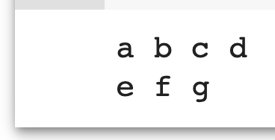
I/O
Standard Output
Output to Console: print(object1, object2, ...)
print('a', 'b', 'c', 'd')
print('e', 'f', 'g')
Open file: file_object=open(file, mode)
write()
Always close file
Note: This removes any existing file with that name
Notes:
Now with inputting comes outputting, and there are two main ways to do this as well. The first is the (click) print function, which like before corresponds to the console. You can add as many objects as you like to the print function, and all of them will be printed out one after another, separated by spaces. (click through animation)
As before, we can (click) write to files in a very similar way as we read from them, only instead of using the read() functions we will use the (click) write() function. There is only a single function to write luckily, and as always make sure you’re (click) closing the file! It’s also important to note that if you’re writing to a file that already exists, (click) any content previously in that file will be wiped out, so be careful with your file names.
colab

Slide 45
Lecture Outline
Google Colab
I/O
List Manipulation
General Python Syntax
What is a function?
Variables
Built-ins
Logic
Importing
Control Flows
Notes:
Next, we’ll go ahead and talk a little bit more about lists.

Slide 46
List Manipulation
Indexing
List Operations
Listcomp
String/list Interop
Notes:
When you look at a list, there are 4 main categories of manipulations that we will need when we’re working with lists for ML: indexing, list operations, listcomps, and string/list interoperations.

Slide 47
List Manipulation
Indexing
[a, b, c, d, e]
0 1 2 3 4
-5 -4 -3 -2 -1
Single indexing
list_name[ ]
i
0
3
1
list_name[-2]
List slicing
list_name[ : ]
i j
1 4
Notes:
There are two main ways we use indexing as you can see here. You can call a (click) single index like (click) this, which notably starts at 0 if you’re counting forward and -1 if you’re counting backward (as in 0 items from the first, or the first item coming backwards).
For example, (click) this is the 0th index, (click) this is the 3rd index, and (click) this is the 1st. (click) You can index from the back of the list, like (click click) this. (click)
You can also (click) slice the list (click) like this, which basically means you’re taking a continuous chunk out of the list. When you slice, you should remember that the first index is inclusive, while the second index isn’t (click) (e.g. index 4 won’t be included in this slice here). (click)

Slide 48
Self-Test
List Manipulation
Indexing
arr = [4, 5, 6, 101, 102, 103, 104, 105]
new_arr = arr[2:6]
print(new_arr)
What does the following code output?
A. [5, 6, 7, 101, 102, 103, 104, 105]
B. [6, 7, 101, 102, 103, 104, 105]
C. [6, 101, 102, 103, 104]
D. [6, 101, 102, 103]

Slide 49
Self-Test
List Manipulation
Indexing
arr = [4, 5, 6, 101, 102, 103, 104, 105]
new_arr = arr[2:6]
print(new_arr)
What does the following code output?
A. [5, 6, 7, 101, 102, 103, 104, 105]
B. [6, 7, 101, 102, 103, 104, 105]
C. [6, 101, 102, 103, 104]
D. [6, 101, 102, 103]
Notes:
colab

Slide 50

List Manipulation
Indexing
List Operations
Listcomp
String/list Interop

Slide 51
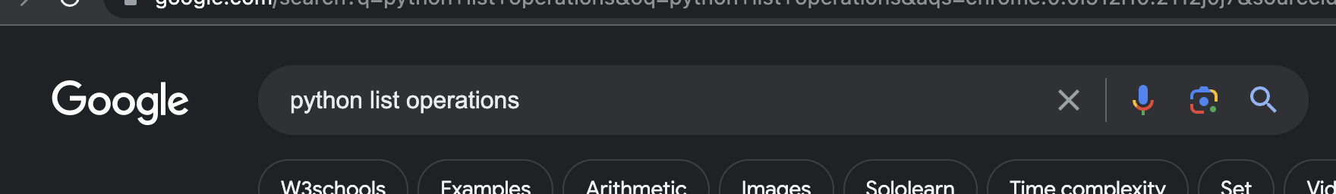
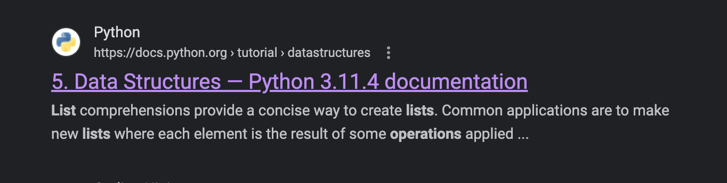
List Manipulation
List Operations
https://docs.python.org/3/tutorial/datastructures.html
1
2
Notes:
Before we get into the actual functions themselves, I would like to point out that you can find a comprehensive list of all of the functions here: (click). If you’d like, you can also (click) search up “python list operations” and then (click) click on this link here.
Much easier to just search it up rather than guess and check that you memorized a function correctly. With that being said, let’s go ahead and take a look at a couple of the most relevant list operations.

Slide 52
List Manipulation
List Operations
my_list =
[3, 14, 0, -2, 5
]

Slide 53
List Operations
append()
[3, 14, 0, -2, 5
]
my_list.append(19)
Notes:
The first thing we can do is to add, or (click) append, new elements to the end of the list.

Slide 54
List Operations
append()
[3, 14, 0, -2, 5, 19
[3, 14, 0, -2, 5
,
19
]
my_list.append(19)
my_list.append( )
8
Notes:
For example, we might add 19 like this, then (click)

Slide 55
List Operations
append()
[3, 14, 0, -2, 5, 19
,
8
]
my_list.append(19)
my_list.append(8)
Notes:
8 like this… (click)

Slide 56
List Operations
remove()
-2,
5, 19, 8]
[3, 14, 0, -2, 5, 19, 8]
[3, 14, 0,
my_list.remove(-2)
Notes:
It’s also possible to remove items if we wanted to. For example, we can take out -2 like this (click). The remove function will then (click) search for the first occurrence of the element we want to remove, and remove it.

Slide 57
List Operations
remove()
5, 19, 8]
[3, 14, 0, 5,
19,
8]
[3, 14, 0,
my_list.remove(-2)
my_list.remove(19)
Notes:
And then 19 like this…

Slide 58
List Operations
remove()
[3, 14, 0, 5,
[3, 14, 0, 5, 8]
8]
my_list.remove(-2)
my_list.remove(19)

Slide 59
List Operations
pop()
1
,
[3, 14, 0,
1,
14, 5, 8]
my_list.pop(3)
Notes:
There’s also a variation of remove that’s known as pop. The only major difference between remove and (click) pop is that remove doesn’t return anything, while pop will return the value at the index that was just “popped” from the list.

Slide 60
List Operations
pop()
[3, 14, 0,
14
,
5, 8]
14, 5, 8]
my_list.pop(3)
1
my_list.pop(3)
Notes:
So here, if we pop index 3, we’ll get 1. If we do it again…

Slide 61
List Operations
pop()
[3, 14, 0, 5, 8]
[3, 14, 0,
5, 8]
my_list.pop(3)
1
my_list.pop(3)
14
Notes:
We’ll get 14.

Slide 62
List Operations
+
]
[3, 14, 0, 5, 8
my_list_2 = [
10, 9, 8, 7]
my_list = my_list + my_list_2
Notes:
Another thing we can do with lists is addition, where adding any two lists will simply append all of the elements of the second list to the first.
So say we have this other list (click) my_list_2. Then, if we want to append the whole list to the end of my_list, we can do something like (click) this.

Slide 63
List Operations
+
[3, 14, 0, 5, 8
10, 9, 8, 7]
,
my_list_2 = [10, 9, 8, 7]
my_list = my_list + my_list_2
Notes:
So this is what happens if we add my_list and my_list_2 and then assign it back to my_list.

Slide 64
List Operations
len()
[0, 3, 5, 7, 8, 8, 9, 10, 14]
len(my_list)
9
Notes:
The last few functions are more utility functions that describe the list, and they include (click) len(), which gives you the (click) length of the list

Slide 65
List Operations
max()
[0, 3, 5, 7, 8, 8, 9, 10, 14]
max(my_list)
14
Notes:
(click) max, which returns the (click) max value

Slide 66
List Operations
min()
[0, 3, 5, 7, 8, 8, 9, 10, 14]
min(my_list)
0
Notes:
and (click) min, which returns the (click) min value

Slide 67
List Manipulation
Indexing
List Operations
Listcomp
String/list Interop

Slide 68
List Manipulation
Listcomp
Shorthand for “for” loops
new_list = [expression for object in iteration]
[obj1, obj2, obj3, obj4, obj5, obj6, obj7 ...]
[new1, new2, new3, new4, new5, new6, new7 ...]
expression
Notes:
For even cleaner code that uses less lines, you can consider using list comprehension, which is basically like (click) a shorthand for a “for” loop. Usually, you want to use them when you generate a new list based on an existing list, string, or range, and when you want to (click) (click) iterate an expression for every object in a list kind of like this.

Slide 69
List Manipulation
Listcomp
new_list = [(i+1)/2 for i in range(7)]
[0, 1, 2, 3, 4, 5, 6]
(i+1)/2
[0.5, 1.0, 1.5, 2.0, 2.5, 3.0, 3.5]
Notes:
For example, this code is saying for each of the 7 elements in the list, add one to it and then divide it by 2 and assign it to the corresponding value here. (click click click while explaining)

Slide 70
List Manipulation
Indexing
List Operations
Listcomp
String/list Interop
Notes:
The last thing that we need to think about is String/list Interoperations

Slide 71
String/list Interop
join()
List of strings
my_list = [str1, str2, str3]
separator
separator
separator.join(my_list)
Notes:
Say you have a (click) list of strings like (click) this. There exists a special function, known as (click) join(), which can take a separator and append all of the strings back-to-back, separated by the separator.
More or less a utility function that saves you from having to write a for loop.

Slide 72
String/list Interop
join()
List of strings
my_list = [str1, str2, str3]
separator.join(my_list)
Final String
str1
separator
str2
separator
str3
Notes:
Once we run this code, the resulting string will look something like (click) this here.

Slide 73
String/list Interop
join()
my_list = ["Hello,", "my", "name", "is", "Bob!"]
' '.join(my_list)
' '
' '
' '
' '
Notes:
If we want to look at an actual example, we can take this for example:
(click and describe)

Slide 74
String/list Interop
join()
my_list = ["Hello,", "my", "name", "is", "Bob!"]
' '.join(my_list)
"Hello, my name is Bob!"
Notes:
We can see each string will be combined together, with a space between each.
Colab. Also go through slicing. questions?

Slide 75
Lecture Outline
Google Colab
I/O
List Manipulation
General Python Syntax
What is a function?
Variables
Built-ins
Logic
Importing
Control Flows
Notes:
Our final topic here is functions.

Slide 76
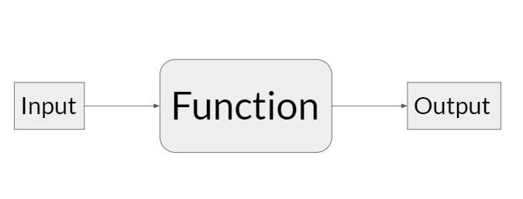
What is a function
Reusable block of code with optional inputs and outputs
Like a factory
Notes:
In essence, functions are some sort of reusable code block that takes in an input and then spits out an output after performing some code on the input.
Keyword is reusable, making our code more organized and easier to maintain.
It also allows us to break down complex tasks into smaller, more manageable parts

Slide 77
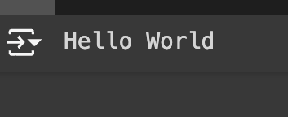
What is a function
print()
Print
"Hello world!"
Notes:
Let’s take a look back at (click) the print function. In this case, the print function takes some sort of input, for example this (click) “Hello world!” string. It will then (click) output the same input to the console.

Slide 78
What is a function
args and kwargs
Normal arguments are based on position (nth input mapped to nth argument)
Kwargs (keyword arguments) are assigned to a particular keyword
Notes:
There’s also a note to be made about two particular parts of the function input: arguments and keyword arguments.
Arguments are essentially anything that is passed into the function, that is, any piece of content that’s contained within the parentheses of the function. Each input will be assigned, based on position, to the corresponding argument.
In comparison, keyword arguments are arguments that are assigned to a particular keyword, and aren’t necessarily positionally oriented in the function’s input.

Slide 79
What is a function
args
They are positional
Can have defaults
def my_function(arg_1=-1, arg_2=-1, arg_3=-1, arg_4=-1):
print(arg_1, arg_2, arg_3, arg_4)
my_function(1,2,3,4)
my_function(3,4)
Notes:
Let’s take a look at an example of arguments first. As a reminder, arguments are considered positional, and by that, it also means that if there aren’t enough inputs passed in, then arguments that aren’t assigned will default to a given default value.
If we have this function that we defined here, then what do we think the first function call will print out?
Right! It’ll print out “1 2 3 4”, since arg_1 will correspond to 1, arg_2 to 2, arg_3 to 3, and arg_4 to 4.
What about the second case? Well, it’ll actually print out “3 4 -1 -1”. This is because arg_3 and arg_4 aren’t assigned, so they will use the default values they were assigned in the function definition at first.

Slide 80
What is a function
kwargs
You can specify a specific argument instead of relying on positions (helpful when there are a lot of arguments and you only need a few)
def my_function(a,b,c,d):
print(a,b,c,d)
my_function(b=2,c=3,d=4,a=1)
Notes:
Now, keyword arguments. Remember that keyword arguments are arguments that you specify, as opposed to relying on the positions. This generally occurs when you’re using only a specific subset of a large number of possible arguments, or if you’re calling the arguments out of order.
Can anyone tell me what the following code prints out? Exactly! It will print out “1 2 3 4”, as this is what value each of the variables now correspond to.
questions?

Slide 81
Lecture Outline
Google Colab
I/O
List Manipulation
General Python Syntax
What is a function?
Variables
Built-ins
Logic
Importing
Control Flows
Notes:
More about Functions

Slide 82
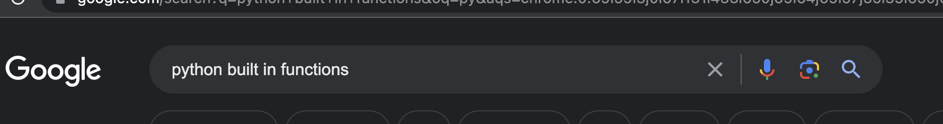
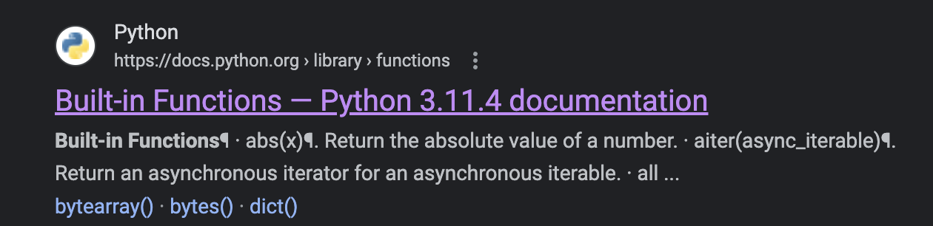
Built-ins
https://docs.python.org/3/library/functions.html
1
2
Notes:
Some of the most common functions can be found (click) here, in the Python documentation once again. These functions are known as “built-ins”, and if you ever need to refer to the documentation about any of them, you can (click) search up “python built in functions” and then go ahead to (click) this link to find the documentation.
Once again, it’s extremely important to get used to this process of referring to the documentation. It is nearly impossible to memorise every single built-in function, and often you’ll get bugs that you don’t quite understand because of something hidden deeper in the documentation, even if you know what the function does.

Slide 83
Lecture Outline
Google Colab
I/O
List Manipulation
General Python Syntax
What is a function?
Variables
Built-ins
Logic
Importing
Control Flows
Notes:
Last but not Least

Slide 84


Importing
Burp
Scikit-learn
Module
Notes:
Outside of the built-ins, we can also import functions from libraries outside (click) the Scikit-learn library we will be using in future labs. You can think of importing as something like this, where we grab a (click) module and (click) feed it into Python, allowing (click) you to have access to all of its packages.
Importing is particularly important because we don’t want to reinvent the wheel. Other people have already heavily optimized and published modules and functions and we can build up from that foundation.
There are three main ways to import a function…

Slide 85
Importing
import sklearn
from sklearn import linear_model
import pandas as pd
Notes:
Firstly, you can simply (click) import the whole package, for example what we’re doing here with sklearn. This brings in all of the functions within the sklearn package.
You can also (click) import a specific function or set of functions by doing this. In essence, you’re saying you want to take in this specific set of functions from this specific package.
Finally, if you want to alias the package name as something different, you can use the “as” keyword and do something like (click) this.

Slide 86
That was a lot!
Let’s get to the lab!
Notes:
Questions. Thats it
Let’s get to the lab

